Slide 1
Haskell
Important concepts
22-Oct-15

Slide 2
Pure functions
A pure function computes a result based only on its input arguments
  Given the same arguments, a pure function will always return the same result
  A pure function has no side effects--all it does is return a result
Changing anything in the environment is a side effect
Input and output are side effects

Slide 3
Referential transparency
A function is referentially transparent if the call to the function can be replaced by the result of the function, without affecting the behavior of the program
  Pure functions are referentially transparent
  A program composed solely of pure functions can be reduced, step by step, into a single result
Consequently, it is much easier to prove the correctness of such programs
Proponents of functional programming claim that this also makes it easier for humans to reason about such programs

Slide 4
Immutable and persistent
An immutable data structure is one that, once created, cannot be modified
  It can be used as a basis for creating a new data structure (for example, creating a “new” list with an additional element)
A persistent data structure is an immutable data structure that shares part of its structure with other immutable data
  Persistence allows new data structures to be created without massive expense
A language is single assignment if, once a variable has been assigned a value, the value of that variable cannot be changed

Slide 5
Functional programming languages
While definitions differ in detail, a functional programming language is generally considered to have these features:
  Functions are first-class values: They can be stored, passed around, etc., just like any other values
    Higher-order functions are functions that take functions as arguments, or produce functions as a result, or both
  Literal (anonymous) functions are supported
  Functions are pure
  The language is expression oriented, not statement oriented
  Data is immutable and persistent
  Variables are single-assignment

Slide 6
Higher-order functions
map applies a function to each element of a list, producing a list of results
filter applies a predicate to each element of a list, producing a list of those elements that satisfy the predicate
reduce (or fold) applies a binary function
f :: a -> a -> a to successive elements of a list, returning a single result
  Variations on reduce:
    An initial value may or may not be provided
    The function may be applied left-to-right or
    right-to-left

Slide 7
Currying and composition
Currying absorbs a parameter into a function, producing a new function
  Example:
  elem 3 [1, 2, 3, 4]
  is equivalent to
  (elem 3) [1, 2, 3, 4]
Function composition is combining two or more functions into a single function
  Example:
  (head . tail) [1, 2, 3, 4]
  is equivalent to
  head (tail [1, 2, 3, 4])

Slide 8
Closures
A closure is when a function uses variables from its immediate environment (usually an enclosing function)
  Example:
  Prelude> let y = 7
  Prelude> let g = \x -> x + y
  Prelude> g 10
  17
  In this example, y is a free variable (not bound in the function)
    The immutable value of y is “closed over” and held by the function g
    Prelude> let y = 5
    Prelude> g 100
    107

Slide 9
Type inference
Haskell uses Hindley-Milner type inference, by which it is able to determine the type of all variables and expressions
  Most errors in Haskell are type errors
  Good style requires the user to provide the type of each user-defined function--this allows almost all errors to be caught

Slide 10
Typeclasses
A typeclass defines a set of functions applicable to variables of a given type
  Examples:
    Variables belonging to the typeclass Eq supply the functions = and \=
    The typeclass Ord extends Eq with the functions <, <=, >=, >.

Slide 11
Laziness
In Haskell, all values are lazy--they aren’t computed until they are needed
  This allows the definition of infinite sequences
  Example:
  fibs = 0 : 1 : zipWith (+) fibs (tail fibs)
  Explanation:
  0 1 1 2 3 5 8 13
  0 1 1 2 3 5 8
  ---------------------------------------------
  0 1 (1,1) (2,1) (3,2) (5,3) (8,5) (13,8)
  0 1 2 3 5 8 13 21

Slide 12
Maintaining state
Pure functions and state are incompatible
  Pure functions are independent of the environment
  State is the environment
To have state and pure functions, the old state of the world must be passed in as a parameter, and the new state of the world returned as a result

Slide 13
Monads I
Monads are a way of “quarantining” impure actions so as not to contaminate the rest of the code
  Code in a monad can use pure functions
  Pure functions cannot use code in a monad
Maybe is a monad that keeps a possible value of Nothing from escaping into the rest of the code
Input and output operations are only defined in the IO monad
  The type of getLine is IO String
  The type of putStrLn is String -> IO ()

Slide 14
Monads II
There are three basic operations for a monad:
  return puts something into a monad:
  return :: Monad m => a -> m a
  “bind”, >>=, takes a value out of a monad, applies a function to it, and puts the result back into a monad:
  (>>=) :: Monad m => m a -> (a -> m b) -> m b
  “then”, >>, takes two monads and discards the first:
  (>>) :: Monad m => m a -> m b -> m b
Haskell’s do evaluates any number of expressions and returns the value of the last one
  do is syntactic sugar for a sequence of “then” operations

Slide 15
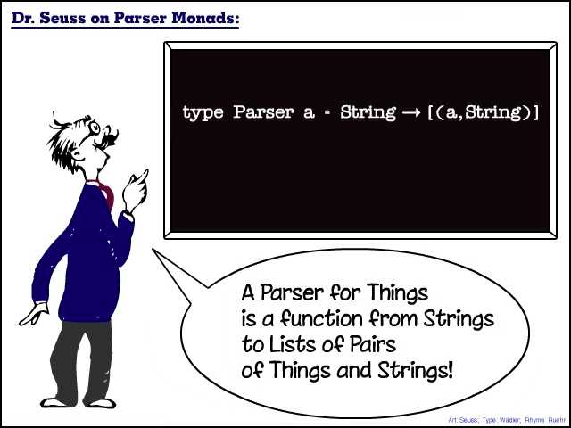
The End

