Slide 1
Getting Git to work with Eclipse:
The least fun thing you’ll ever do
By Orren Saltzman

Slide 2

Why am I qualified to talk about this?
I probably have some minor form of OCD
As a result, I spent valuable time learning about this when I should have been working on the actual assignments
I’ve voluntarily been helping others to set up their Git Repos, for practice (or maybe because I enjoy pain)
I didn’t spend hours on the githug assignment typing nonsense into a black box for nothing
I take it personally when software doesn’t do as I say.

Slide 3
Where do we even start?
We could start in Eclipse:
Create a new project from the package directory
Create a new local repo (git init)
Create a new empty remote repo on github.com
Connect them using (git remote add origin <url>)
Make some commits
Attempt to push to remote repo using (git push origin)

Slide 4

Where do we even start?
We could start in Eclipse:
Create a new project from the package directory
Create a new local repo (git init)
Create a new empty remote repo on github.com
Connect them using (git remote add origin <url>)
Make some commits
Attempt to push to remote repo using (git push origin)
Receive cryptic and mysterious error messages you can do nothing about:
Go insane, fail classes, drop out of MCIT, become a crazy hobo

Slide 5

Where do we even start?
We could start at github:
Create a remote repo through github.com
Download it into your eclipse workspace using
Frantically refresh your package directory for fifteen minutes
- Punch your computer in its stupid computer face

Slide 6
The real problem is:
Getting Eclipse to recognize git repositories as project folders
Dealing with invisible folders managed by git:
- .git
- .gitignore
Dealing with invisible folders managed by Eclipse:
- .settings
- .project
- .classpath
The Eclipse ones appear to be platform specific (yay)

Slide 7
One possible Solution: Egit!
- A Git plugin/GUI for Eclipse. Perfect!

Slide 8
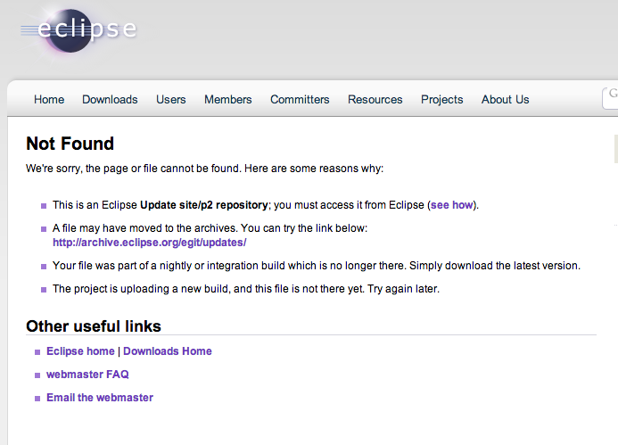
One possible Solution: Egit!
- A Git plugin/GUI for Eclipse. Perfect!
Actually, don’t do this

Slide 9
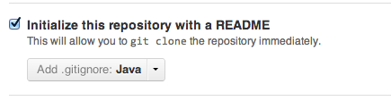
OK, so what’s the right thing to do?
It’s probably best to start the repo on github
Allow github to create your README file (I don’t know why, just do it)
Also allow it to create a .gitignore file and set it to Java (this part is just convenient)
When you’re done, github helps you out with a screen on what to do next:

Slide 10
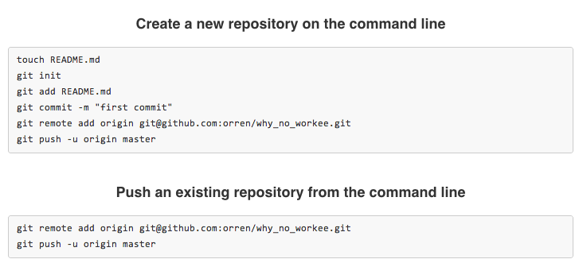
First of all, stare at this for awhile because you’ll never get back to it without starting over
What does the -u argument mean?
Didn’t we try this remote add nonsense once already?

Slide 11
Cloning
- We’ll get back to -u in a minute
For now, how about we clone rather than copy
The github native app is extremely useful for this
Install it, and all of a sudden you have this!
The same thing exists for windows
If you’re on the linux cluster, no app, but this also works:
Navigate to Eclipse workspace in terminal
git clone <url>
Just don’t use git init, it’s messier and you’ll get more network errors

Slide 12
A quote:
“Eclipse is a terrible piece of software and no one should ever use it.”
                Orren Saltzman

Slide 13

Eclipse import wizard
There’s a chance you’ll open up Eclipse and the project will just appear. If it does, don’t question it. Just move on with your life.
If not, right click on your package explorer and click
If you’re on a Linux machine, you may see a git option in this wizard that will allow you to clone remote repos directly. This worked the one time I tried it, so it’s definitely worth a shot.
If you’re using a mac, you won’t see this option.
Try General > Existing Projects into Workspace
Last resort: General > File system

Slide 14
Before you do anything else!
Add the invisible Eclipse files to .gitignore
You don’t want your partner getting these, they need to make their own
format: One ignore per line, wildcards allowed (*)
Finally, it’s time to make our first commit….

Slide 15

So you want to commit…
You aren’t out of the woods yet. Your first commit from here is a delicate process.
You can try add, commit, push like normal
If this doesn’t work, try fetch, pull, push.
This will be necessary if git thinks something has changed on github for some reason.
Sometimes it will give you this crap:
Just do what it says and specify ‘master’ after ‘origin’

Slide 16
Y U NO USE –U?!
By the way, the -u argument in push means ‘upstream’, and defines the remote repo you specify as the default and central repo
If you successfully use (git push origin -u) once, you never have to specify the remote name again, just (git push)

Slide 17
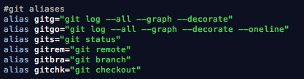
Some things to make this easier:
Aliases!
If you haven’t used them yet, they can save you tons of time.
Those first two are the absolute best thing of ever

Slide 18
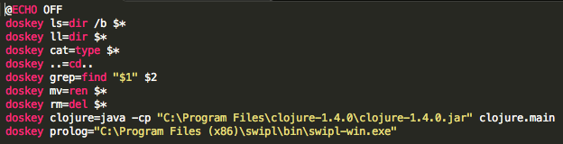
Aliases on Windows
(Added by Dave)
The Windows equivalent of alias is doskey
Here’s an example file:
Name it (for example) aliases.bat, run as aliases

Slide 19
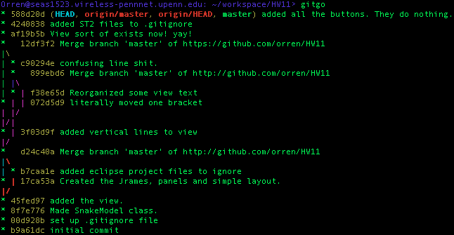
Branches, tags, and remote content, all viewable from the terminal

Slide 20
Some source material
Lots of info online, but none of it is well- curated
The Tuts+ Premium video course on git essentials
https://tutsplus.com/course/git-essentials/
Unfortunately, there’s a monthly fee, but I would recommend paying for one month, downloading everything that interests you, and then cancelling.

Slide 21

Congrats, you’ve survived

Slide 22
A final note…
If you would like to refer to this presentation in the future (and I can’t imagine why) I put it on the web
But unfortunately, I placed it in a github repo, so you’ll probably never find it.
Username: orren
Repo name: why_no_workee

